Slide 1
Index
Introduction
What is MVC
MVC Architecture
Model, View and Controller basics
Folder structure of MVC
Advantages using of MVC
Difference between ASP.NET web form and MVC
ASP.NET MVC Pipeline

Slide 2
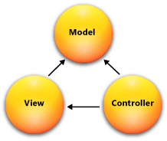
Introduction to MVC
The Model-View-Controller (MVC) architectural pattern separates an application into three main components: the model, the view, and the controller. The ASP.NET MVC framework provides an alternative to the ASP.NET Web Forms pattern for creating Web applications
The MVC framework is defined in the System.Web.Mvc assembly.

Slide 3
Model
The Model represents the application core (for instance a list of database records).
The Model represents a set of classes that describes the business logic and data. It also defines business rules for how the data can be changed and manipulated
Moreover, models in Asp.Net MVC, handles the Data Access Layer by using ORM tools like Entity Framework or NHibernate etc.
Models are stored in the Models folder of the project

Slide 4
Views
Views are the components that display the application's user interface (UI). Typically, this UI is created from the model data.
The View displays the data (the database records).
The view is only responsible for displaying the data, that is received from the controller as the result.

Slide 5
Controllers
The Controller is responsible for controlling the application logic and acts as the coordinator between the View and the Model.
The Controller receive input from users via the View, then process the user's data with the help of Model and passing the results back to the View.
Moreover, controllers in Asp.Net MVC, respond to HTTP requests and determine the action to take based upon the content of the incoming request.
Controllers are stored in the Controllers folder of the project.

Slide 6
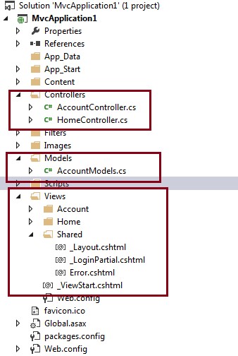

Slide 7
Versions of MVC
Asp.Net MVC1
Released on Mar 13, 2009
Runs on .Net 3.5 and with Visual Studio 2008 & Visual Studio 2008 SP1
MVC Pattern architecture with WebForm Engine
Html Helpers
Ajax helpers
Routing
Unit Testing

Slide 8
Asp.Net MVC2
Released on Mar 10, 2010
Runs on .Net 3.5, 4.0 and with Visual Studio 2008 & 2010
Strongly typed HTML helpers means lambda expression based Html Helpers
Templated Helpers
Support for Data Annotations Attribute
Client-side validation
UI helpers with automatic scaffolding & customizable templates
Attribute-based model validation on both client and server
Overriding the HTTP Method Verb including GET, PUT, POST, and DELETE
Areas for partitioning a large applications into modules
Asynchronous controllers

Slide 9
Asp.Net MVC3
Released on Jan 13, 2011
Runs on .Net 4.0 and with Visual Studio 2010
The Razor view engine
Improved Support for Data Annotations
Remote Validation
Compare Attribute
Sessionless Controller
Child Action Output Caching
Dependency Resolver
Entity Framework Code First support
Partial-page output caching
ViewBag dynamic property for passing data from controller to view
Global Action Filters
Better JavaScript support with unobtrusive JavaScript, jQuery Validation, and JSON binding
Use of NuGet to deliver software and manage dependencies throughout the platform
Good Intellisense support for Razor into Visual Studio

Slide 10
Asp.Net MVC4
Released on Aug 15, 2012
Runs on .Net 4.0, 4.5 and with Visual Studio 2010SP1 & Visual Studio 2012
ASP.NET Web API
Enhancements to default project templates
Mobile project template using jQuery Mobile
Display Modes
Task support for Asynchronous Controllers
Bundling and minification
Support for the Windows Azure SDK

Slide 11
Asp.Net MVC5
Released on 17 October 2013
Runs on .Net 4.5, 4.5.1 and with Visual Studio 2013
ASP.NET Scaffolding
Authentication filters - run prior to authorization filters in the ASP.NET MVC pipeline
Bootstrap in the MVC template
ASP.NET MVC 5 requires .NET 4.5 at least
ASP.NET Web API2

Slide 12
Disadvantages of ASP.NET Web forms
Project Architecture
There is no fixed predefined Project Architecture for creating web applications when it comes to Web Forms. Developers have full flexibility for choosing their own architecture.
Unit Testing
In Web Forms code behind ends up with lots of event handlers, making automatic unit testing an impossible task
Performance
ViewState becomes solution for some problems with classic ASP but it also becomes an issue. ViewState is stored in the page itself resulting increased page size so reduced performance.
Reusability- Reusing same code behind for multiple pages is not possible
SEO –URL’s are pointing to fixed ASPX pages which might be decorated with some query string. They are not user friendly and affect SEO.
Less support for parallel development - ASPX page are tightly coupled with code behind files. So it’s not possible that 2 different developers are working on one section (one on aspx and one on code behind) at same time.

Slide 13
Advantages of the ASP.NET MVC Framework
SoC – Separation of Concerns-
The MVC framework provides a clean separation of the UI , Business Logic , Model or Data.
Test Driven development
In MVC controller is a separate class so automatic testing is possible featuring Test Driven Development.
Reusability -
Controllers are not bound to any specific view and so can be reused for multiple views.
Performance - ASP.NET MVC don’t have support for view state, so there will not be any automatic state management which reduces the page size and so gain the performance.
Full control over HTML - ASP.NET MVC doesn’t support server controls, only option available is using html input controls, so we will be sure about final html rendered at the end.

Slide 14
Advantages of the ASP.NET MVC Framework
Support for parallel development - In ASP.NET MVC layers are loosely coupled with each other, so one developer can work on Controller ,at the same time other on View and third developer on Model. This is called parallel development.
Extensibility - ASP.NETMVC supports multiple view engines like aspx, razor and if required we can create our own.

Slide 15
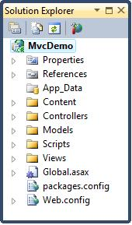
MVC folder structure
Application information
Properties References
Application folders
App_Data Folder Content Folder Controllers Folder Models Folder Scripts Folder Views Folder
Configuration files
Global.asax packages.config Web.config

Slide 16
The App_Data Folder
The App_Data folder is for storing application data
We can add an SQL database to the App_Data folder
The Content Folder
The Content folder is used for static files like style sheets (css files), icons and images.
Visual Web Developer automatically adds a themes folder to the Content folder. The themes folder is filled with jQuery styles and pictures. In this project you can delete the themes folder
Visual Web Developer also adds a standard style sheet file to the project: the file Site.css in the content folder. The style sheet file is the file to edit when you want to change the style of the application.

Slide 17
Controllers Folder
The Controllers folder contains the controller classes responsible for handling user input and responses.
MVC requires the name of all controller files to end with "Controller".
Models Folder
The Models folder contains the classes that represent the application models
Views Folder
The Views folder stores the HTML files related to the display of the application (the user interfaces).
The Views folder contains one folder for each controller.

Slide 18
The Scripts Folder
The Scripts folder stores the JavaScript files of the application.
By default Visual Web Developer fills this folder with standard MVC, Ajax, and jQuery files:

Slide 19
_ViewStart File
The _ViewStart file in the Shared folder (inside the Views folder) contains the following content:
@{
Layout = "~/Views/Shared/_Layout.cshtml";
}
This code is automatically added to all views displayed by the application.
If you remove this file, you must add this line to all views

Slide 20
Use of _ViewStart is for DRY (do not repeat yourself). This view is for providing/managing the standard layout view to all views from one place

Slide 21
ASP.NET MVC Pipeline
1. Routing Engine
User Reqest
Search for Controller
2
Found
Not Found
Controller
Model
View Engine

Slide 22
The above image is a highlevel showing how ASP.NET MVC handles an incoming request
from a user.
Step 1: The request goes through the ASP.NET stack and is handed over to the routing engine the first
thing.
Step 2: Based on the route configuration, the routing engine looks for the appropriate controller. If
the controller is found, it is invoked. If not found, a Controller not found is returned by the Routing
engine.
Step 3: The Controller interacts with the Model as required. If there is incoming data, Model binding is
done by ASP.NET MVC to make the incoming data into a strongly type Model if required.
Step 4: The model if invoked, retrieves or save appropriate data and returns to the controller.
Step 5: The controller then requests for a View with (or without) the data from Model. There may be
one or more View engines registered so MVC Cycles through all the View engine until it finds one and
renders the view. Then hands over the request to the ViewEngine which returns the Result to the
Controller. The Controller send back the Result as a part of the HTTP response.
This is a highly simplified view of course. However the key steps remain the same.
The takeaway in this diagram is that ASP.NET MVC is dealing with straight HTTP, there is no
ViewState munging or other fancy state management in the pipeline

Slide 23
Page life cycle MVC
Request
HTTP
Routing
Route
Route Handler
HTTP
Handler
Controller
View Engine
View
Response

Slide 24
Routing Pipeline
Request
UrlRoutingModule
MvcRoutingModule
MvcHandler
IController
IControllerFactory

Slide 25
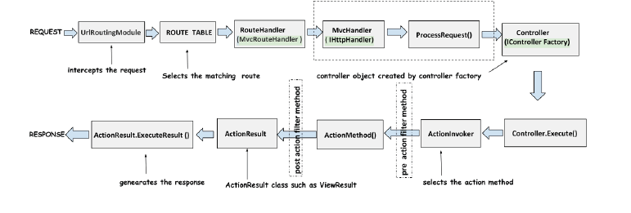

Slide 26
UrlRouteModule- The entry to the Mvc application
First, the incoming request is handled by the UrlRouteModule, which is responsible for matching the requested URL to a route in the application. UrlRouting Module selects the first matching route.
UrlRouting Module knows about these routes using the maproute method
Maproute is the extension method.
Behind the scenes it associates the routeHandler with the routes.Internally MapRoute method is implemented as:
var Default = new Route(url, defaults , routeHandler);
So basically what this method does is attach a routeHandler with the route.
UrlRoutingModule is defined as

Slide 27
The URLRoutingModule attaches the route handler to the routes.

Slide 28
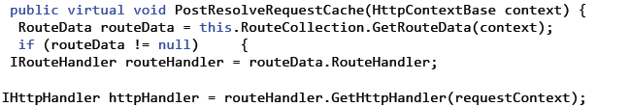
RouteHandler- Generator of MvcHandler
The MvcRouteHandler object creates an instance of the
MvcHandler and passes the instance of RequestContext to MvcHandler
MvcRouteHandler implements the IRouteHandler interface.
When the MvcRouteHandler is created one of the things it do is to call the PostResolveRequestCache﴾﴿ method.
PostResolveRequestCache﴾﴿ method is defined as

Slide 29
Following happens in the PostResolveRequestCache﴾﴿ method:
RouteCollection property has a GetRouteData() method.This GetRouteData() method is called and passed the HttpContext.
GetRouteData() method returns the RouteData object
routeData has a RouteHandler property which returns the IRouteHandler for the current request which is the MvcRouteHandler.
This MvcRouteHandler has the GetHttpHandler() method which returns the reference to the MvcHandler
It then delegates control to the new MvcHandler instance.

Slide 30
MvcHandler- Initiating MVC applications.
The MvcHandler is responsible for initiating the real processing inside ASP.NET MVC.
The MvcHandler class implements three interfaces : IHttpAsyncHandler, IHttpHandler and IRequiresSessionState.
MVC handler implements IHttpHandler interface and further process the request by using ProcessRequest method as shown below

Slide 31
protected internal virtual void ProcessRequest(HttpContextBase httpContext)
{
SecurityUtil.ProcessInApplicationTrust(delegate {
IController controller;
IControllerFactory factory;
this.ProcessRequestInit(httpContext, out controller, out factory);
try
{
controller.Execute(this.RequestContext);
}
finally
{
factory.ReleaseController(controller);
}
});
}

Slide 32
ProcessRequest﴾﴿ method calls the ProcessRequestInit﴾﴿ method which is defined as:
private void ProcessRequestInit(HttpContextBase httpContext,
out IController controller, out IControllerFactory factory) {
// If request validation has already been enabled, make it lazy.
// This allows attributes like [HttpPost] (which looks at Request.Form) to work correctly without triggering full validation.
bool? isRequestValidationEnabled = ValidationUtility.IsValidationEnabled(HttpContext.Current);
if (isRequestValidationEnabled == true) {
ValidationUtility.EnableDynamicValidation(HttpContext.Current);
}
AddVersionHeader(httpContext);
RemoveOptionalRoutingParameters();
// Get the controller type
string controllerName = RequestContext.RouteData.GetRequiredString("controller");
// Instantiate the controller and call Execute
factory = ControllerBuilder.GetControllerFactory();
controller = factory.CreateController(RequestContext, controllerName);
if (controller == null) {
throw new InvalidOperationException(String.Format(CultureInfo.CurrentCulture,MvcResources.ControllerBuilder_FactoryReturnedNull,
factory.GetType(),controllerName));
}
}

Slide 33
In the ProcessRequest() method following happens:
ProcessRequestInit() method is called which creates the ControllerFactory.
This ControllerFactory creates the Controller.
Controller's Execute() method is called

Slide 34
ControllerFactory-The generator of Controller
ProcessRequest﴾﴿ method is that ControllerFactory is obtained that is used to create the Controller object
Controller factory implements the interface IControllerFactory.
By default the framework creates the DefaultControllerFactory type when the ControllerFactory is created using the ControllerBuilder.
The ControllerBuilder is a singleton class and is used for creating the ControllerFactory.
Following line in the ProcessRequestInit﴾﴿ method creates the ControllerFactory.
factory = ControllerBuilder.GetControllerFactory();

Slide 35
GetControllerFactory﴾﴿-
This method returns the ControllerFactory object. So now we have the ControllerFactory object.
Create controller-
ControllerFactory uses the CreateController method to create the controller. CreateController is defined as:
IController CreateController(RequestContext requestContext, string controllerName )

Slide 36
Controller
the ControllerFactory creates the Controller object in the ProcessRequest() method of the MvcHandler.
Now this Controller class inherits from another Controller class called the "ControllerBase" whi
public abstract class ControllerBase : IController
{
protected virtual void Execute(RequestContext requestContext)
{
if (requestContext == null)
{
throw new ArgumentNullException("requestContext");
}
if (requestContext.HttpContext == null)
{
throw new ArgumentException(
MvcResources.ControllerBase_CannotExecuteWithNullHttpContext,"requestContext");
VerifyExecuteCalledOnce();
Initialize(requestContext);
using (ScopeStorage.CreateTransientScope())
{
ExecuteCore();
}
}

Slide 37
After the controller object is created using the controller factory following happens :
The Execute() method of the controllerbase is called
This Execute() method calls the ExecuteCore() method which is declared abstract and is defined by Controller class.
The Controller class's implementation of the ExecuteCore() method retrieves the action name from the RouteData
ExecuteCore() method calls ActionInvoker's InvokeAction() method.

Slide 38
Action invocation
Once the controller has been instantiated, Controller's ActionInvoker determines which specific action to invoke on the controller.
The ActionInvoker is an object of a type that implements the IActionInvoker interface. The IActionInvoker interface has a single method defined as:
bool InvokeAction
(ControllerContext controllerContext, string actionName)
The ControllerActionInvoker object is associated with a controller object that is responsible for determining which action of the controller is called, then the controller invokes this action method.
The selected action is called based on the ActionNameSelectorAttribute attribute ﴾by default it is the same as the Action name﴿.
This ActionNameSelectorAttribute helps us to select the correct action method if more than one action method is found that has the same name. In this stage the action filters are also applied.

Slide 39
ActionResult
Instead of returning different data types it always returns the ActionResult type. ActionResult is an abstract class which is defined as:
public abstract class ActionResult
{
public abstract void ExecuteResult(ControllerContext context);
}
As the ExecuteResult﴾﴿ is an abstract method so different sub class's provides different implementations of the Execut
MVC supports many builtin action result return types, like ViewResult,RidirectToRouteResult, RedirectResult, ContentResult, EmptyResult and JsonResult.

Slide 40
Following happens after the action method is invoked.
The OnActionExecuting methods of the ActionFilters are invoked.
After this the action method itself is invoked.
After the action method is invoked the OnActionExecuted methods of ActionFilters are invoked.
The ActionResult is returned back from the ActionMethod
The ExecuteResult() method of the ActionResult is called.

Slide 41
ViewEngine-The Renderer of the View
ViewResult is one of the most common return type used in almost all of the applications. It is used to render a view to the client using the ViewEngine.
It is handled by IViewEngine interface of the view engine
View Engine is responsible for rendering HTML to the browser.
Currently there are four built-in View Engines ﴾Razor, ASPX, Spark and NHaml﴿ supported by MVC
We can also use multiple View Engines simultaneously in ASP.NET MVC.
An Action method may return JSON data, a simple string or file. Commonly an Action Result returns a ViewResult.

Slide 42
Layout and section in MVC
_Layout.cshtml is like master page-
It maintains consistent look and feel across all of the pages within your web-site or application.
ASP.NET 2.0 introduced the concept of “Master Pages”. So in Razor view engine supports the concepts with a feature called layout.
ViewStart file with in Views folder used the default Layout page for your ASP.NET MVC application

Slide 43
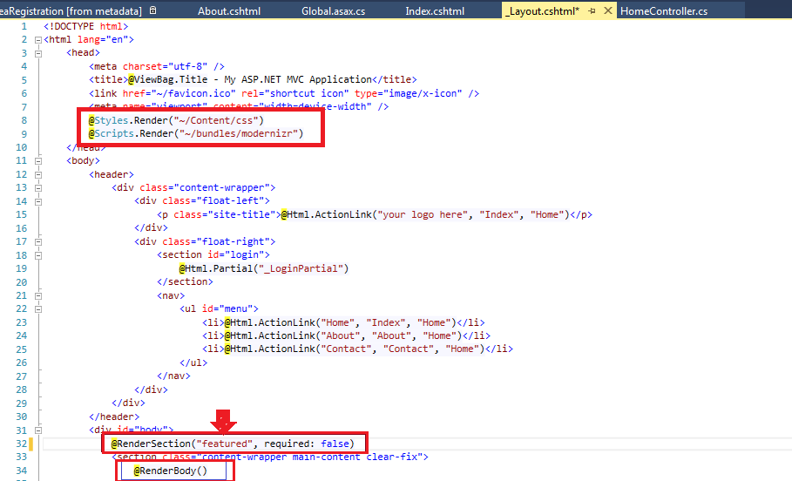
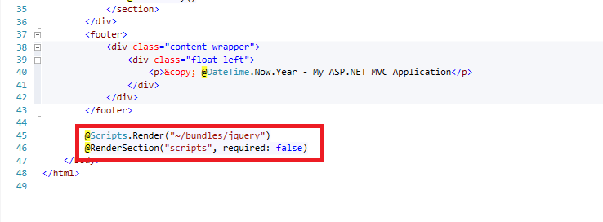
_Layout.cshtml file

Slide 44
Styles.Render
Style.Render is used to render a bundle of CSS files defined within BundleConfig.cs files. Styles.Render create style tag﴾s﴿ for the CSS bundle.
Scripts.Render
Scripts.Render is also used to render a bundle of Script files by
rendering script tag﴾s﴿ for the Script bundle.
Notes:-
1. Styles.Render and Scripts.Render generate multiple style and script tags for each item in the CSS bundle and Script bundle when optimizations are disabled.
2. When optimizations are enabled, Styles.Render and Scripts.Render generate a single style and script tag to a version‐stamped URL which represents the entire bundle for CSS and Scripts.

Slide 45
RenderPage in ASP.NET MVC
RenderPage method also exists in the Layout page to render other page exists in your application
A layout page can have multiple RenderPage method. This is achieved by using the RenderPage method.
This method takes either one or two parameters. The first is the physical location of the file, the second is an optional array of
objects that can be passed into the page.

Slide 46
RenderSection in ASP.NET MVC
Layout pages also have the concept of sections. A layout page can only contain one RenderBody method, but can have multiple sections.
The difference between RenderSection and RenderPage is RenderPage reads the content from a file; whereas RenderSection runs code blocks you define in your content pages
A view can define only those sections that are referred to in the layout page otherwise an exception will be thrown.
A view can define only those sections that are referred to in the layout page otherwise an exception will be thrown.

Slide 47
RenderBody
RenderBody method exists in the Layout page to render child page/view. It is just like the ContentPlaceHolder in master page.
A layout page can have only one RenderBody method.
@RenderBody()

Slide 48
Routing in MVC
A route is a URL pattern. Routing is a pattern matching process that monitors the requests and determines what to do with each request. In other words we can say Routing is a mechanism for mapping requests within our MVC application.
The ASP.NET MVC framework uses the ASP.NET routing engine
A route is a URL pattern that is mapped to a handler
A handler is the controller in an MVC application
Request first served by a URLRoutingModule object. URLRoutingModule is nothing but HTTPModule. This module parses the request
This Module contains all routes that are registered in the Global.asax file under the Application_Start event

Slide 49
protected void Application_Start()
{
AreaRegistration.RegisterAllAreas();
RegisterRoutes(RouteTable.Routes);
}
public static void RegisterRoutes(RouteCollection routes)
{
routes.IgnoreRoute("{resource}.axd/{*pathInfo}");
routes.MapRoute(
"Default", // Route name
"{controller}/{action}/{id}", // URL with parameters
new { controller = "Home", action = "Index", id = UrlParameter.Optional } // Parameter defaults
);
}
The default value is used if a value for that parameter is not included in the URL

Slide 50
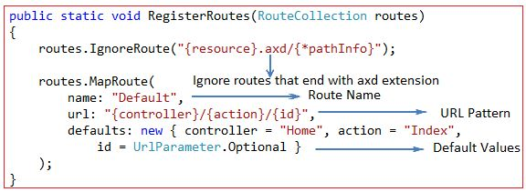
URL | Controller | Action | Id
http://MVCDemo/ | HomeController | Index
http://MVCDemo/Book/ | BookController | Index
http://MVCDemo/Book/Create | BookController | Create
http://MVCDemo/Book/Edit/2 | BookController | Edit | 2

Slide 51
Rules for Routes
In a MVC application, a route table must have at least one route definition
An application has only one RouteTable and this is setup in the Application_Start event of Global.asax of the application.
Route name should be unique across the entire application. Route name can’t be duplicate.
In a URL pattern, you define placeholders by enclosing them in braces ( { and } ).
You can define more than one placeholder in a segment, but they must be separated by a literal value.

Slide 52
{employee}-{salary}/{action} - valid route pattern
{employee}{salary}/{action} - not a valid pattern,
because there is no literal value or delimiter between the placeholders. Therefore, routing cannot determine where to separate the value for the employee placeholder from the value for the salary placeholder.

Slide 53
Route Constraints
Suppose we have a placeholder called employeeId and we have defined this employeeId as an integer argument of an action method. So if the user enters the string value for this employeeId parameter he will get an exception. We can use a route constraint in this case to limit the employeeId value to integer values.
routes.MapRoute
( name: “Employee",
url: “Employee/{employeeId }",
defaults: new { controller = “Employee", action = "Details"}, constraints:new{id=@"\d+"}
);

Slide 54
How routing works
Suppose that you add routes with the following patterns:
Route 1: {controller}/{action}/{id}
Route 2: products/show/{id}
Route 2 will never handle a request because Route 1 is evaluated first, and it will always match requests that could also work for Route 2. A request for http://server/application/products/show/bikes seems to match Route 2 more closely, but it is handled by Route 1 with the following values:
controller = products
action = show
id = bikes

Slide 55
Why Use Routing
Routing enables you to use URLs that do not have to map to specific files in a Web site
More easily understood by users
In Asp.net Web Form we have URL like below
www.computerproducts.com/material.aspx?matid=4
Say id 4 is for CD
If we need to get DVD info need to pass id for DVD
www.computerproducts.com/material.aspx?matid=5

Slide 56
Those URLs are hard to remember for end users
Instead think about below urls
www.computerproducts.com/material/product/cd
www.computerproducts.com/material/product/dvd
The above URLs seem self explanatory and the user can easily guess that if we sell CDs he just have to append cd at the end of the common UR

Slide 57
Partial View
A partial view is like as user control in Asp.Net Web forms that is used for code re‐usability.
Partial views are reusable views like as Header and Footer views
Creating A Partial View
A partial view has same file extension﴾.cshtml﴿ as regular view.
To create a partial view do right click on shared
folder ﴾\Views\Shared﴿ in solution explorer and click on "Add New View" option and then give the name for partial
view and also checked the Create a partial view option.

Slide 58
It is best practice to create partial view in the shared folder and partial view name is preceded by "_", but it is not mandatory. The "_" before view name specify that it is a reusable component i.e. partial view.

Slide 59
Difference between View and Partial View
Partialview mostly does not content html attribute like head , tag , meta and body while view can have all this attribute
Partialview is reusable content which is render inside view(parent page)
Partialview mostly used with Ajax request to process fast and update particular portion while view load whole page.
Partialview generally process with mvc Ajax.ActionLink and Ajax.Beginform while View process with mvc Html.ActionLink and Html.Beginform

Slide 60
Razor
Razor is not a new programming language itself, but uses C# syntax for embedding code in a page without the ASP.NET delimiters: <%= %> . It is a simple-syntax view engine and was released as part of ASP.NET MVC 3. The Razor file extension is "cshtml" for the C# language

Slide 61
Rendering Partial View
The Partial, RenderPartial, RenderAction helper methods are used to render partial view in mvc3 razor.
@Html.Partial("_EmployeeDetails")
@{Html.RenderPartial("_ EmployeeDetails ");}
The main difference between above two methods is that the Partial helper method renders a partial view into a
string while RenderPartial method writes directly into the response stream instead of returning a string.

Slide 62
Partial Vs Render Partial
Html.Partial returns a String, Html.RenderPartial calls Write internally, and returns void. Renderpartial does exactly the same thing and is better for performance over partial().
NOTE
Partial or RenderPartial methods are used when a model for the page is already populated with all the information

Slide 63
Render Partial View Using jQuery
To load a partial view with in a div we need to do like as:
<script type="text/jscript">
$('#divpopup').load('/shared/_ProductCategory’);
</script>

Slide 64
Html.RenderPartial
Result will be directly written to the HTTP response stream
This method returns void
No need to create any action
RenderPartial method is useful used when the displaying data in the partial view is already in the corresponding view model
This method is faster than Partial method since its result is directly written to the response stream which makes it fast.

Slide 65
Html.RenderAction
Result will be directly written to the HTTP response stream
We need to create a child action for the rendering the partial view.
RenderAction method is useful when the displaying data in the partial view is independent from corresponding view mode

Slide 66
Advantages of MVC – based Web Applications
Easier to manage complexity by dividing application in to the model, view and controller
It does not use view state
It uses a Front Controller pattern that processes Web application requests through a single controller. This enables you to design an application that supports a rich routing infrastructure.
It provides better support for test-driven development (TDD).

Slide 67
Areas in MVC
Area was introduced in MVC2
Areas allow us to organize models, views, and controllers into separate functional sections of the application.
Registering Area:
Before working with area, make sure you have registered your area with in the Application_Start method in Global.asax as shown below.
AreaRegistration.RegisterAllAreas();

Slide 68
Bundling and minification
Bundling and minification are two techniques you can use in ASP.NET 4.5 to improve request load time. Bundling and minification improves load time by reducing the number of requests to the server and reducing the size of requested assets (such as CSS and JavaScript.)
When we create a new ASP.NET MVC 4 application, bundles are automatically configured
The configured bundles are in a file named BundleConfig.cs in the App_Start folder

Slide 69
Bundling
Bundling is a new feature in ASP.NET 4.5 that makes it easy to combine or bundle multiple files into a single file. You can create CSS, JavaScript and other bundles. Fewer files means fewer HTTP requests and that can improve first page load performance

Slide 70
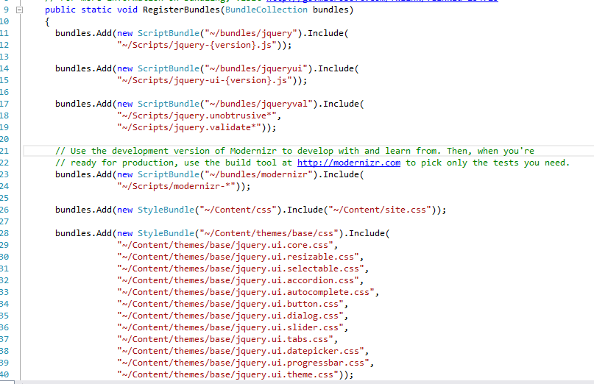

Slide 71
Minification
It’s a process of removing unnecessary whitespace, line break and comments from code.
It reduces the size of file to improve load times.

Slide 72
Action Result Helper Methods
Redirect - Returns a RedirectResult, which redirects the user to the appropriate URL.
RedirectToAction - Returns a RedirectToRouteResult, which redirects the user to an action using the supplied route values
View- Returns a ViewResult, which renders the view to the response
PartialView- Returns a PartialViewResult
Content- Returns a ContentResult, which writes the specifi ed content
(string) to the response
File-Returns a class that derives from FileResult, which writes binary content to the response.
Json-Returns a JsonResult containing the output from serializing an object to JSON.
JavaScript- Returns a JavaScriptResult containing JavaScript code that is immediately executed when returned to the client

Slide 73
Action Result Types in MVC
ASP.NET MVC includes several ActionResult types for performing common tasks.
ActionResult class is the base class for all action results. There are different ActionResult types
ActionResult | Helper Method | Description
ViewResult | View | Renders a view as a web page
PartialViewResult | PartialView | Section of a view,that can be rendered inside another view
RedirectResult | Redirect | Redirect to another action method
RedirectToRouteResult | RedirectToRoute | Redirect to another action method
ContentResult | Content | Returns a user-defined content type
JsonResult | Json | Retuns a serialized JSON object
JavaScriptResult | JavaScript | Returns a script that can be executed on the client
FileResult | File | Returns a binary output to write to the response
EmptyResult | (None) | returns a null result

Slide 74
Validations in MVC
MVC has following approaches to do validations
By using Data Annotations
By using ModelState object
By Using jQuery Validation Plug-in

Slide 75
By Using Data Annotations.
(Server side validation)
Add namespace System.ComponentModel.DataAnnotations in Model
Add validation attributes like below
Required
RegularExpression
Range
Compare
StringLength

Slide 76
2. By using ModelState object (Explicit Model Validation)
To validate model explicitly use ModelState object in ActionMethod in controller.
The model state is use to represent validation errors
Add error messages in model state as below
ModelState.AddModelError("address", "Please Enter Address");

Slide 77
3. By Using jQuery Validation Plug-in
When we create MVC project in VS 2012 then the client side becomes enabled by default. So we can easily disable or enable in web.config
<configuration>
<appSettings>
<add key="ClientValidationEnabled" value="true" />
<add key="UnobtrusiveJavaScriptEnabled" value="true" /> </appSettings>
</configuration>

Slide 78
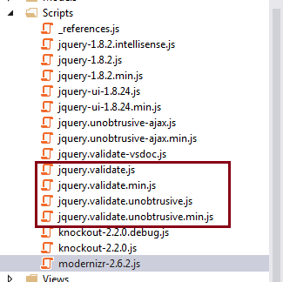
This is client side validation where there is no page reload.
For this we use Jquery plugin
jquery.validate.min.js
jquery.validate.unobtrusive.min.js
In MVC 4 by default these files are added
When we create new project

Slide 79
Custom Validation
Create separate class for validation which is inherited from ValidationAttribute
Implement IsValid method

Slide 80
HTML Helpers
HTML Helper is just a method that returns a HTML string.
HTML Helpers to render standard HTML tags like HTML <input>,
<button> and <img> tags etc.

Slide 81
Different Types of HTML Helpers
1] Built in HTML Helpers (Standard HTML Helpers)
A list of most common standard html helpers is given below
TextBox - @Html.TextBox﴾"Textbox1", "val"﴿
Output: <input id="Textbox1" name="Textbox1" type="text" value="val" />
TextArea - @Html.TextArea﴾"Textarea1", "val", 5, 15, null﴿
Output: <textarea cols="15" id="Textarea1" name="Textarea1“ rows="5">val</textarea>
Password - @Html.Password﴾"Password1", "val"﴿
Output: <input id="Password1" name="Password1" type="password" value="val"/>
Hidden Field - @Html.Hidden﴾"Hidden1", "val"﴿
Output: <input id="Hidden1" name="Hidden1" type="hidden" value="val" />
CheckBox - @Html.CheckBox﴾"Checkbox1", false﴿
Output: <input id="Checkbox1" name="Checkbox1" type="checkbox" value="true"/> <input name="myCheckbox" type="hidden" value="false" />

Slide 82
RadioButton - @Html. RadioButton﴾"Radiobutton1", "val", true﴿
Output: <input checked="checked" id="Radiobutton1" name="Radiobutton1"
type="radio" value="val" />
Drop‐downlist –
@Html.DropDownList ﴾“DropDownList1”, new SelectList﴾new [] {"Male", "Female"}﴿﴿
Output: <select id="DropDownList1" name="DropDownList1">
<option>M</option> <option>F</option> </select>
Html Link - @Html.ActionLink(“EmpName:Mahendra”, “Details")
The first parameter is the link text, and the second parameter is the name of the controller action.
Output: <a href="/Home/Details">EmpName:Mahendra</a>

Slide 83
Strongly typed HTML Helpers
These helpers are used to render the HTML elements in strongly typed view.
The HTML elements are create based on model properties.
These helpers work on lambda expression
Most Common Strongly Type HTML Helpers are
TextBox- @Html.TextBoxFor﴾m=>m.Name﴿
TextArea- @Html.TextArea﴾m=>m.Address , 5, 15, new{}﴿﴿
Password- @Html.PasswordFor﴾m=>m.Password﴿
Hidden Field - @Html.HiddenFor﴾m=>m.UserId﴿
CheckBox - @Html.CheckBoxFor﴾m=>m.IsActive﴿
RadioButton - @Html.RadioButtonFor﴾m=>m.IsActive, "val"﴿

Slide 84
Templated HTML Helpers
These helper renders HTML elements based on properties of model class.
It makes the use of DataType attribute of DataAnnitation class
For example, when you use DataType as Password, A templated helper automatically render Password type HTML input element.

Slide 85
Custom HTML Helpers
Custom HTML Helpers used to create our own Html Helpers.
There are following ways to create custom html helpers
1. Creating a static method
2. Writing an extension method
3. Using the @helper﴾razor only﴿

Slide 86
ASP.NET MVC Filters and Attributes
An action filter is an attribute that you can apply to a controller action ‐‐ or an entire controller
ASP.NET MVC filters perform logic either before an action method is called or after an action method runs.
ASP.NET MVC Filter Types
Authorization filter
Responsible for checking User Access, these implement theIAuthorizationFilter interface in the framework. The AuthorizeAttribute and RequireHttpsAttribute are examples of Authorization Filters.
Action Filters
These implement the IActionFilter interface that have two methods OnActionExecuting and OnActionExecuted. OnActionExecuting runs before the Action and gives an opportunity to cancel the Action call.
Result Filters
This filter will execute before and after the result of the action method has been executed. We can use this filter if we want some modification to be done in the action's result.
The OutputCacheAttribute class is one example of a result filter.

Slide 87
Exception filter
which executes if there is an unhandled exception thrown somewhere in action method, starting with the authorization filters and ending with the execution of the result. Exception filters can be used for tasks such as logging or displaying an error page
The HandleErrorAttribute class is one example of an exception filter.
Filter Order
Filters run in the following order:
Authorization filters
Action filters
Response filters
Exception filters

Slide 88
Exception handling in ASP.NET MVC
In ASP.NET MVC exception can be handled by following ways
Try… Catch
Overriding OnException method
Using the [HandleError] attribute on actions and controllers
Setting a global exception handling filter
Handling Application_Error event

Slide 89
1.Try..Catch
It is applicable to any piece of C# code, not specific to ASP.NET MVC
2. Overriding OnException Method
Try..Catch allows errors to trap at code level
OnException() method allows to trap errors at application level.
protected override void OnException(ExceptionContext filterContext)
{
……
…….
RedirectToAction("Error", "Home");
}

Slide 90
3. HandleError- Exception filter
In ASP.NET applications, error handling is done mostly in two ways: at local level using try-catch blocks and at global level using application events.
ASP.NET MVC comes with some built-in support for exception handling through exception filters.
ASP.Net MVC has an attribute called "HandleError" that provides built‐in exception filters.
HandleError Attribute:
The exception filters are attributes that can be applied over an action or a controller or even at a global level.
When you apply the filter at the global level then it will handle the exceptions raised by all the actions of all the controllers.
The exception filters not only catches the exceptions that are raised by the actions but also the ones that are raised by the action filters that are applied over the actions.
Set in Web.Config <customErrors mode="On"></customErrors> for HandleError to work

Slide 91
The HandleError attribute is the default implementation of IExceptionFilter.
When we create a MVC application, the HandleError attribute is added within the Global.asax.cs file and registered in the Application_Start event.
1. HandleError at action level
[HandleError]
public ActionResult Index()
{
return View();
}
2. HandleError at controller level
[HandleError]
public class HomeController : Controller
{
……..
}

Slide 92
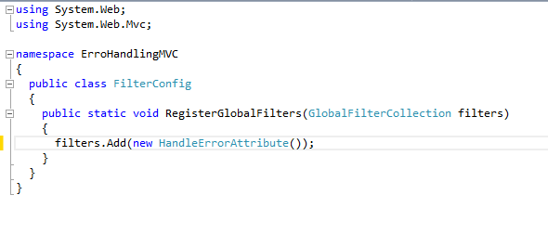
3. HandleError at Global level
We can register the HandleError attribute class (HandleErrorAttribute) as a global error handling filter
To do so, open Global.asax and add this code in the Application_Start event handler:
Any unhandled exception that takes place within the boundary of the MVC application will now be handled by this global error handler.

Slide 93
Catch Specific Type of Error
Returning different views for different exceptions
We can return different views from the HandleError filter
[HandleError(Exception = typeof(DbException), View = "DatabaseError")]
[HandleError(Exception = typeof(AppException), View = "ApplicationError")]
public class ProductController
{
}

Slide 94
Accessing the exception details in Error view
The HandleError filter not only just returns the Error view but it also creates and passes the HandleErrorInfo model to the view.
Here is the definition of the HandleErrorInfo.
public class HandleErrorInfo
{
public HandleErrorInfo(Exception exception, string controllerName,string actionName);
public string ActionName { get; }
public string ControllerName { get; }
public Exception Exception { get; }
}

Slide 95
Limitation of HandleError attribute
The HandleError filter has some limitations by the way.
No Support to log the exception
Doesn't catch HTTP exceptions other than 500
Doesn't catch exceptions that are raised outside controllers
Return error view even for exceptions occurred in AJAX calls

Slide 96
HandleError vs. Application_Error
Exception filters are not global error handlers and this is an important reason that forces us to still rely on Application_Error event.
Some programmers don't even use the HandleError filter in their application at all and use only the Application_Error event for doing all the error handling and logging work.
Out of MVC context - The important problem we face in the Application_Error event is, once the program execution reaches this point then we are out of MVC context and because of that we can miss some context information related to the exceptionApplication_Error event.
HandleError can return different views – Using HandleError exceptions are raised from one controller we have to return a custom error view and for other controllers we have to return a different error view, this could be easily accomplished through exception filters but not easily through the Application_Error event

Slide 97
Security in ASP.NET MVC
Authentication and Authorization
Authentication -
Authentication is verifying that users are who they say they are, using some form of login mechanism
Authorization -
Authorization is the ability to grant or deny access to resources, according to the rights defined for the different kinds of entities requesting them. This is usually achieved using some type of role-based system.

Slide 98
Authentication
There are two authentication mechanisms in MVC :
Windows Authentication
Forms Authentication
Windows Authentication:
The Intranet application project template is chosen to provide windows-based authentication where all users are authenticated by using Active Directory managed by windows server.
Windows authentication is done by selection project template
Intranet Application
Internet Application (Further settings are required)

Slide 99
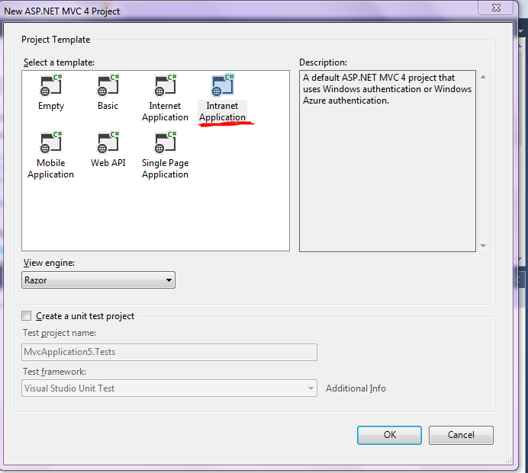
Intranet Application
Step 1. Select this project template then automatically Windows Authentication is enabled

Slide 100

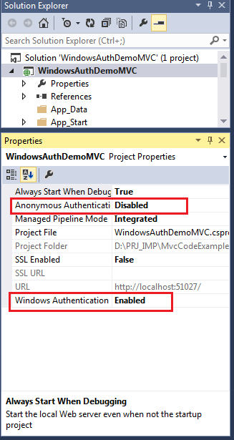
After selecting this template below code added in web.config file
Step 2- Select project and click F4 to edit properties
Set Anonymous Authentication as Disabled
and Windows Authentication as Enabled.

Slide 101
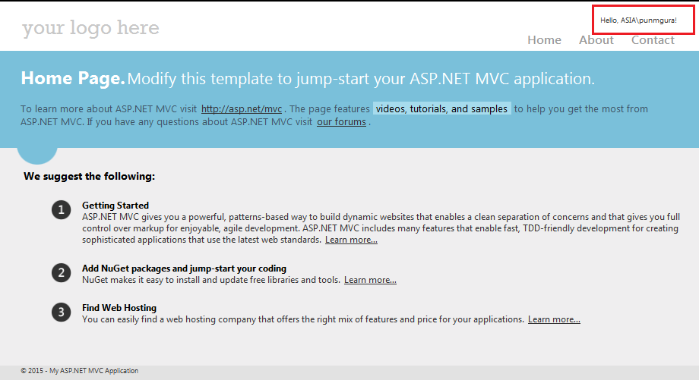
Step 3- Run the application
In the upper‐right corner of the browser, you see your domain or workgroup user name.

Slide 102
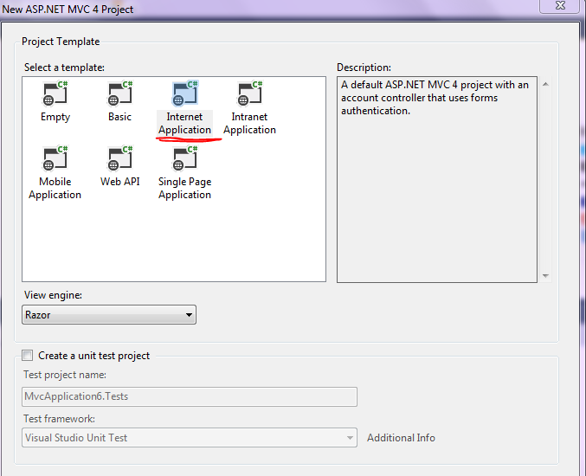
Internet Application
Step 1. Select this project template, but by default Forms Authentication is enabled

Slide 103


After selecting this template below code added in web.config file
Step 2. Repeat same step as in last process of pressing F4
Step 3. As we are target to do windows Authentication need to do below changes in web.config file
Enable Windows Authentication and add Authorize section as below
Add below keys in web.coinfig
<add key="autoFormsAuthentication" value="false" />
<add key="enableSimpleMembership" value="false"/>

Slide 104
Forms Authentication
Form based authentication is providing an input form where users can enter the username and password with accompanying logic in the application needed to validate those credential
Implementing Forms Authentication
Step 1- Select Internet Application template

Slide 105
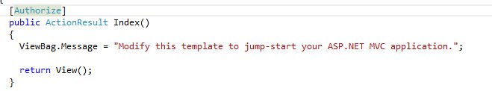
Step 2- Put Authorize attribute for controller action
Default Membership
When we create ASP.NET MVC internet application it creates a Membership database in App_Data folder

Slide 106
